Slide 1
Transport in Plants
GCE Study Buddy
Biology

Slide 2
Transport system of flowering plants
The vessels that transport materials in plants is known as the vascular tissue
There are two main transport tissues:
Xylem
Phloem

Slide 3
Xylem
Functions
Conduct water and mineral salts from roots to stems and leaves
Provide mechanical support
Structure
Xylem tissue consists mainly of xylem vessels
A xylem vessel is a long hollow tube made of many dead cells
Inner walls are strengthened by lignin – rings or spirals

Slide 4
Lignin Patterns
Rings
(annular)
Spiral
Scalariform
Reticulate
Pitted

Slide 5
Adaptations of the Xylem
Feature | Adaptation
Empty lumen without protoplasm or cross walls | Reduces resistance to water flow, allowing for rapid transport of water
Walls thickened with lignin | Lignin is hard and rigid. It prevents collapse of the vessel

Slide 6
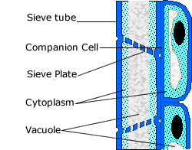
Phloem
Functions:
Translocates sucrose and amino acids from the leaves to other parts of the plant.
Structure
Consists of two elements: sieve tube and companion cells

Slide 7
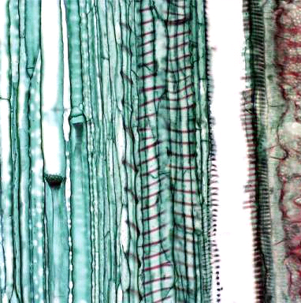
Phloem
Sieve tube
Sieve tube cells or sieve tube elements
Elongated, thin walled LIVING cells
Cells separated by sieve plates
Cross walls that are perforated with pores = sieve
Sucrose is loaded into the sieve tube by active transport.
Sieve tube cell
Xylem
Sieve plate

Slide 8
Sieve tube cells
Mature sieve-tubes has thin lining of cytoplasm.
Nucleus, central vacuole as well as most organelles are disintegrated.
Degenerated protoplasm
Sieve tube cells need help to sustain life
Companion cells ‘accompany’ them and ‘feed’ them

Slide 9
Companion cells
Each sieve tube cell has a companion cell beside it
This carries out the metabolic processes to keep both cells alive
Structure:
narrow, thin-walled, many mitochondria. Has cytoplasm and a nucleus
Function:
Provides nutrients and helps sieve tube cells transport food
Notes:
plasmodesmata

Slide 10
Phloem
Feature | Adaptation
Companion cells have many mitochondria | Provides energy needed for companion cell to load sugars from mesophyll cells into sieve tubes by active transport
Sieve plates have holes | Allows rapid flow of manufactured food substances through sieve tubes

Slide 11
Differences between Xylem and Phloem
Xylem | Phloem
Consists of dead cells | Consists of living cells
-Transports water and mineral salts -Provide mechanical support to the plant | Transports sugar and amino acids
Transport is unidirectional | Transport – directional, upwards and downwards
Substances are transported by passive transport - osmosis, root pressure, capillary action, transpiration pull | Substances are transported by active transport, diffusion

Slide 12
Vascular tissues (Stems)
The xylem and phloem are grouped together to form a vascular bundle
The phloem lies outside the xylem
The two are separated by the CAMBIUM
- The cambium divides and differentiates to form new xylem and phloem tissues

Slide 13
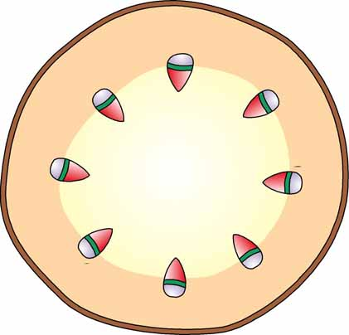
Vascular Bundle
1
vascular bundles
2
pith
5
epidermis
3
xylem
vascular bundle
cambium
phloem
4
cortex

Slide 14
Vascular bundles (Stems)
A stem will contain many vascular bundles arranged in a ring
This surrounds a central region called the pith
The region outside the pith and between the vascular bundles is called the cortex
Both cortex and pith store up food substances e.g. starch
The stem is covered by a layer of cells called the epidermis
The epidermis is protected by the cuticle
This is a waxy, waterproof layer
Reduces loss of water by evaporation

Slide 15
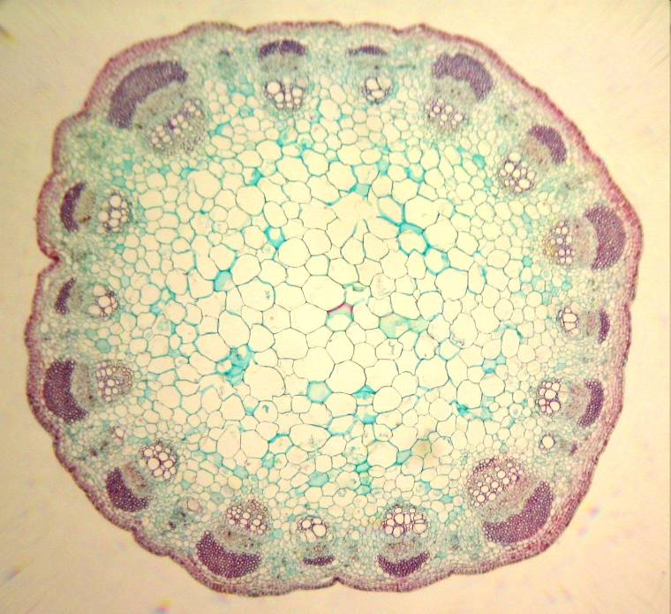
Vascular bundles (Stems)
Phloem
Vascular
Bundle
Cambium
Xylem
Pith
Cortex
Epidermis
Cuticle

Slide 16
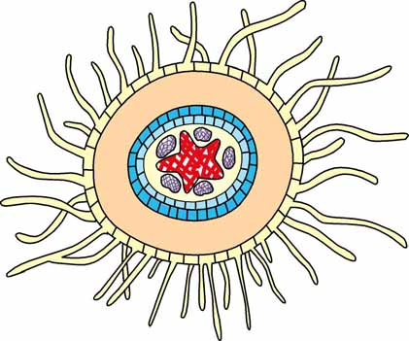
Vascular tissues (Roots)
The xylem and phloem alternate with each other
Pericycle surrounds the vascular tissues
Endodermis surrounds the pericycle
Cortex acts as storage tissue
Tubular outgrowth of an epidermal cell
Increases surface area to volume ratio
Increases efficiency of water/mineral salt absorption
Endodermis
Pericycle
Cortex

Slide 17
Vascular tissues (Roots)
Piliferous layer: this is a epidermal layer that bears root hairs
Cuticle is absent in the piliferous layer
1
xylem and phloem alternate with each other.
4
root hair
2
cortex
endodermis
3
piliferous layer

Slide 18
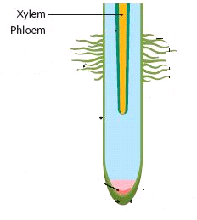
Regions of a root
Zone of maturation
Bears numerous root hairs
Where most of the water and mineral salts are absorbed
Zone of elongation
Cells elongate
Causes increase in root length
Root cap
Covers root tip
Protects young cells from injury
Growing zone
- Small young cells that actively divide
Notes:
How are the cells different?

Slide 19
Translocation
Translocation
The movement of food substances e.g. sugars and amino acids in a plant
Translocation studies
Aphid studies
Ringing experiment
Use of radioactive isotopes

Slide 20
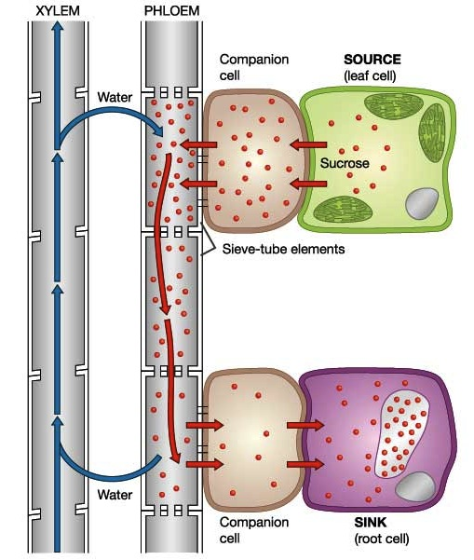
Translocation Pathway
Sugars form in leaf cells, and are actively transported by companion cells (loaded) into phloem.
Bulk flow of water pushes sap to sinks. Sink cells actively remove sugars, and convert them to starches. Water is recycled through xylem.

Slide 21
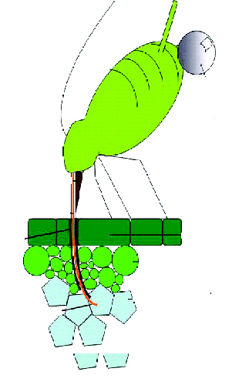
1. Aphid studies
Aphids are insects that feed on plant juices
They have a long mouth piece called a proboscis
The aphid uses its proboscis to penetrate a leaf/stem and feed

Slide 22
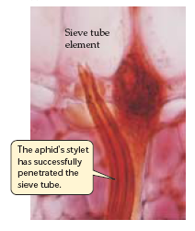
1. Aphid studies
When the aphid is feeding, it is anesthetized with CO₂
The body is cut off, leaving the embedded proboscis
Liquid that exudes from the proboscis contains sucrose and amino acids
Sectioning the stem shows the proboscis is in the phloem sieve tube

Slide 23
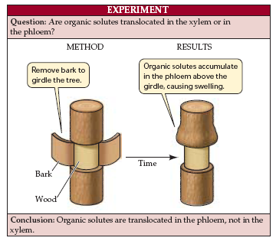
2. Ringing Experiment
Cut off a ring of bark, including the phloem, but leaving the xylem
Immerse in water and observe
Swelling observed above the cut
Due to accumulation of organic solutes that came from higher up the tree and could no longer continue downward because of the disruption of the phloem.
Later, the bark below the girdle died because it no longer received sugars from the leaves.
Eventually the roots, and then the entire tree, died.

Slide 24
3. Use of radioactive isotopes
Carbon-14 (¹⁴C) is a radioactive isotope of carbon
If ¹⁴CO₂ is supplied to the plant, it will be fixed in the glucose upon photosynthesis:
¹⁴C₆H₁₂O₆
When the stem is cut and placed on a X-ray film, only the phloem contains radioactivity

Slide 25
Absorption of water
Into the roots
By osmosis
2. Up the stem
Root pressure
Capillary action
Transpiration pull
3. Out of the leaves
Transpiration

Slide 26
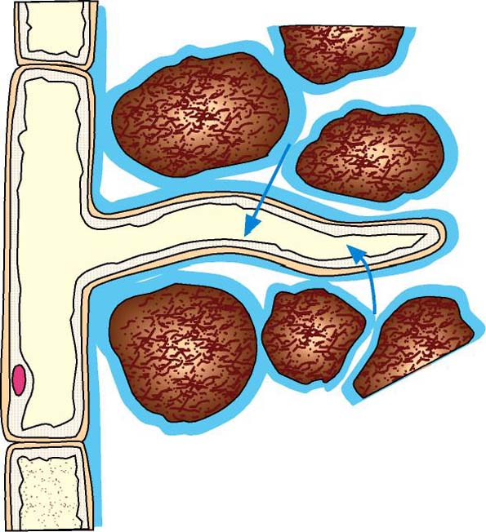
Entry of water into a plant
cytoplasm
soil particles
vacuole
film of liquid (dilute solution of mineral salts)
The thin film of liquid surrounding each soil particle is a dilute solution of mineral salts.
2
2
1
cell surface membrane of root hair cell
nucleus
cell wall
1
Each root hair is a fine tubular outgrowth of an epidermal cell. It grows between the soil particles, coming into close contact with the water surrounding them.

Slide 27
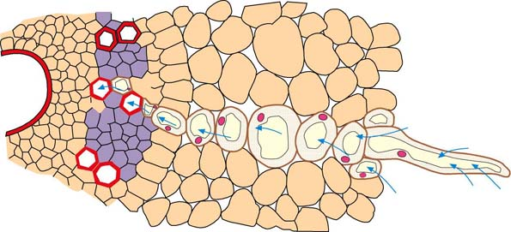
Entry of water into a plant
The sap in the root hair cell is a relatively concentrated solution of sugars and various salts. Thus, the sap has a lower water potential than the soil solution. These two solutions are separated by the partially permeable cell surface membrane of the root hair cell. Water enters the root hair by osmosis.
3
5
water entering the root hair
4
C
B
A
3
root hair
xylem
piliferous layer
phloem
cortex
4
The entry of water dilutes the sap. The sap of the root hair cell now has a higher water potential than that of the next cell (cell B). Hence, water passes by osmosis from the root hair cell into the inner cell.
5
Similarly, water passes from cell B into the next cell (cell C) of the cortex. This process continues until the water enters the xylem vessels and moves up the plant.

Slide 28
1. Into the roots
Root hairs are fine tubular outgrowths
Surrounded by soil particles
Dilute solution of mineral salts surrounds soil particles

Slide 29
Absorption in roots
Root hair cell sap is a concentrated solution of sugars and salts.
The more dilute soil solution has a higher water potential than the cell sap
Water enters the cell sap from the soil solution by osmosis, down the water
potential gradient
Water entry dilutes the sap and raises the water potential
Root hair cell has higher water potential than neighbouring cell
Water moves into neighbouring cell by osmosis, down the w.p.g
Process repeats and water moves from cell to cell, through the root cortex
until it enters the xylem

Slide 30
Ions and mineral salts
Diffusion –when the concentration of minerals salts in the soil solution is higher than that in the root hair cell.
Active transport –when the concentration of ions in the soil solution is lower than that in the root hair cell sap.
The energy comes from cellular respiration in the root hair cells

Slide 31
Adaptations of the root hair cell
 | Feature | Adaptation
1 | Long and narrow | Increases SA:V, thus increasing rate of absorption of water and mineral salts
2 | Has cell surface membrane | Partially permeable Maintains high conc. of sugars, amino acids and salts in cell sap. Results in lower water potential than soil solution so water can enter by osmosis
3 | Is living | Able to provide energy for active transport of ions into cell
4 | Has protein transporters | Able to transport specific mineral ions into the cell.

Slide 32
2. Up the stem
a. Root pressure
Root cells actively pump inorganic ions into the xylem and the root endodermis holds the ions there.
As ions accumulate in the xylem, water enters by osmosis, pushing the xylem sap upward ahead of it.
This force, called root pressure, can push xylem sap up to a few metres.
Root pressure is not enough to bring water up all trees.

Slide 33
2. Up the stem
b. Capillary action
If water is present in a narrow (capillary) tube, forces of attraction exist between:
Water molecules
Water molecules and surface of the tube
Causes water to move up the tubes
Effect is called capillary action
Cannot account for water rising up a tall tree

Slide 34
Up the stem
c. Transpiration pull
Transpiration: Loss of water from aerial parts of plant, especially through stomata of leaves
Transpiration pull: Suction force caused by transpiration
Main factor that causes water to move up the xylem
Transpiration stream: Stream of water moving up

Slide 35
Why is transpiration important?
Draws water and mineral salts from the roots to the stems and the leaves.
Evaporation of water from the cells in the leaves removes latent heat of vaporisation, so the plant is cooled.
Water transported to the leaves is used for photosynthesis and maintaining the turgidity of the leaf cells.

Slide 36
ENVIRONMENTAL FACTORS THAT AFFECT TRANSPIRATION
Temperature of air
Air humidity
Light intensity
Wind/air movement
Carbon dioxide concentration

Slide 37
1. Temperature of air
Higher temperatures increases the rate of evaporation
The higher the temperature, the greater the rate of transpiration
T
Stomata closed
degrees
30

Slide 38
2. Air Humidity
Air inside leaf is saturated with water vapour
Increasing the humidity of the air will decrease the water vapour concentration gradient between the leaf and the atmosphere, therefore decreasing the rate of transpiration
The lower the humidity, the faster the rate of transpiration
T
Humidity

Slide 39
3. Light Intensity
When light intensity is increases, guard cells become turgid.
The stomata opens, increasing the rate of transpiration.
When light intensity is reduced, the stomata closes.
In greater the light intensity, the greater the rate of transpiration
T
Stomata closed

Slide 40
4. Wind/air movement
Blows water vapour away at the surface of leaves
Increases concentration gradient between water vapour in the leaf and outside the leaf
This would increase transpiration
When the air is still, transpiration reduces or stops
The stronger the wind, the faster the rate of transpiration
T
Wind

Slide 41
5. Carbon dioxide concentration
When carbon dioxide concentration in the intercellular spaces of the leaf falls below a critical concentration, the stomata opens. This increases transpiration.
An increase in carbon dioxide concentration decreases the rate of transpiration.
T
Co2 concentration

Slide 42
Wilting
Turgor pressure of mesophyll cells supports the leaf and keep it firm and spread out widely to absorb sunlight for photosynthesis.
In strong sunlight, when the rate of transpiration exceeds the rate of absorption of water by the roots, the cells lose their turgor, become flaccid and the plant wilts.
Wilting also occurs in the soft stems of certain plants in which the stem mesophyll cells lose water.
If rate of transpiration > rate of water absorption, cells become flaccid and plant wilts
Advantages: Reduces rate of transpiration and thus, reduces water loss
Disadvantage: Stomata are closed, reducing entry of CO₂. Rate of photosynthesis decreases

Slide 43
Plant adaptations
Xerophytes -- Plants that live in dry conditions
Adapted to preventing water loss and storing water
Hydrophytes – Water plants
Fully submerged plants adapted to receiving more sunlight
Partially submerged plants adapted to float
Floating plants adapted to float and compete for sunlight

Slide 44
Xerophytes
Mechanism | Adaptation
Limit water loss | Waxy stomata – Reduces water loss by transpiration
 | Few stomata – Reduces transpiration rate
 | Sunken stomata – hairs of grooves trap water vapour that diffuses out. Increases humidity around stomata, therefore reducing transpiration
 | Reduced leaf size – Reduces exposed surface area
 | Curled leaves – Reduces exposed surface area
Water storage | Succulent leaves
 | Succulent stems
 | Fleshy tubers

Slide 45
Hydrophytes
Mechanism | Adaptation
- | Thin/no cuticle. Since cuticle is to prevent water loss, there is less need for cuticle
 | Large intercellular air spaces – aids buoyancy
 | Abundant stomata - No need to reduce water loss - Maximise gaseous exchange

Slide 46
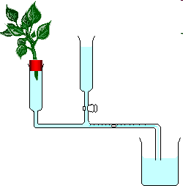
Using a potometer
1. Insert plant into cork with hole
2. Smear opening with petroleum jelly – makes the apparatus airtight
4. As plant transpires,
water moves to replace water lost in the plant. Bubble moves along capillary tube
3. Open tap to fill tube with water

